Slide 1
My Perimeter, Area and Volume Interactive Notebook
Name
Class
Term 3 Semester 2

Slide 2
Contents
Formula Page
Page
Date
Description
2
3

Slide 3
Tasks
24
7
30
Essential Question
Questions
Notes
Summary
4
5

Slide 4
24
7
30
Date
Perimeter and circumference
EQ – How do you find the perimeter of a sector?
5

Slide 5
Task
Label the parts of a circle sheet.
Stick into INB

Slide 6
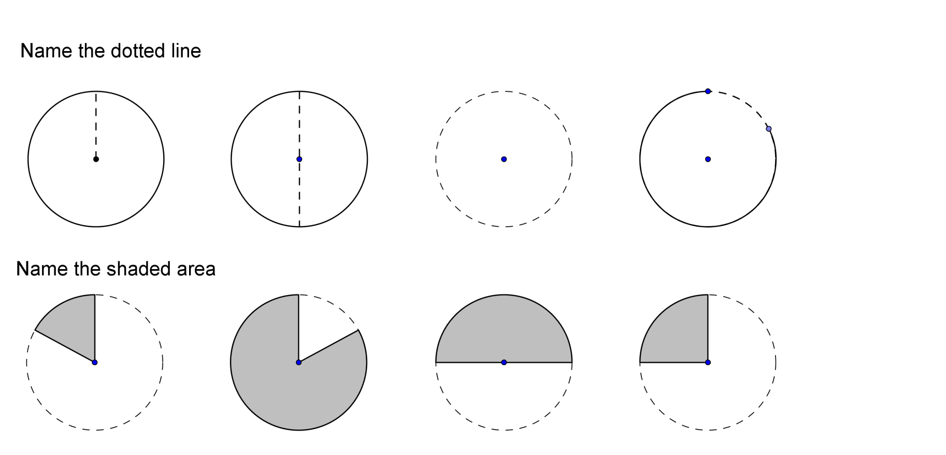

Slide 7
Radius

Slide 8
Radius
Diameter

Slide 9
Radius
Diameter
Circumference

Slide 10
Radius
Diameter
Circumference
Arc

Slide 11
Radius
Diameter
Circumference
Arc
Minor Sector

Slide 12
Radius
Diameter
Circumference
Arc
Minor Sector
Major Sector

Slide 13
Radius
Diameter
Circumference
Arc
Minor Sector
Major Sector
Semicircle

Slide 14
Radius
Diameter
Circumference
Arc
Semicircle
Quadrant
Minor Sector
Major Sector

Slide 15
24
7
30
Date
Perimeter and circumference
EQ – How do you find the perimeter of a sector?
Circumference is the perimeter of a circle
r
d
5

Slide 16

24
7
30
Date
Perimeter and circumference
EQ – How do you find the perimeter of a sector?
Circumference is the perimeter of a circle
r
$C=πd$
d
5

Slide 17

24
7
30
Date
Perimeter and circumference
EQ – How do you find the perimeter of a sector?
Circumference is the perimeter of a circle
r
$C=πd or C=2πr$
d
5

Slide 18
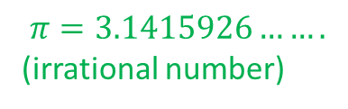
24
7
30
Date
Perimeter and circumference
EQ – How do you find the perimeter of a sector?
Circumference is the perimeter of a circle
r
$C=πd or C=2πr$
d
$$π=3.1415926…….$$
(irrational number)
5

Slide 19
24
7
30
Date
Perimeter and circumference
EQ – How do you find the perimeter of a sector?
Circumference is the perimeter of a circle
r
$C=πd or C=2πr$
d
$$π=3.1415926…….$$
(irrational number)
eg
3m
5

Slide 20

24
7
30
Date
Perimeter and circumference
EQ – How do you find the perimeter of a sector?
Circumference is the perimeter of a circle
r
$C=πd or C=2πr$
d
$$π=3.1415926…….$$
(irrational number)
eg
$$C=2πr$$
3m
5

Slide 21
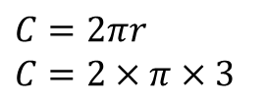
24
7
30
Date
Perimeter and circumference
EQ – How do you find the perimeter of a sector?
Circumference is the perimeter of a circle
r
$C=πd or C=2πr$
d
$$π=3.1415926…….$$
(irrational number)
eg
$$C=2πr$$
$$C=2×π×3$$
3m
5

Slide 22
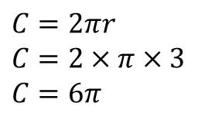
24
7
30
Date
Perimeter and circumference
EQ – How do you find the perimeter of a sector?
Circumference is the perimeter of a circle
r
$C=πd or C=2πr$
d
$$π=3.1415926…….$$
(irrational number)
eg
$$C=2πr$$
$$C=2×π×3$$
$$C=6π$$
3m
5

Slide 23
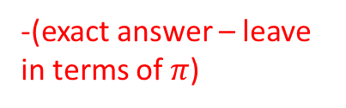
24
7
30
Date
Perimeter and circumference
EQ – How do you find the perimeter of a sector?
Circumference is the perimeter of a circle
r
$C=πd or C=2πr$
d
$$π=3.1415926…….$$
(irrational number)
eg
$$C=2πr$$
$$C=2×π×3$$
$$C=6π$$
3m
-(exact answer – leave in terms of $π$)
5

Slide 24
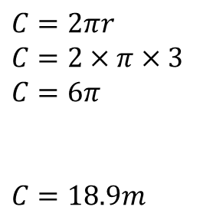
24
7
30
Date
Perimeter and circumference
EQ – How do you find the perimeter of a sector?
Circumference is the perimeter of a circle
r
$C=πd or C=2πr$
d
$$π=3.1415926…….$$
(irrational number)
eg
$$C=2πr$$
$$C=2×π×3$$
$$C=6π$$
$C=18.9m$
3m
-(exact answer – leave in terms of $π$)
5

Slide 25
24
7
30
Date
Perimeter and circumference
EQ – How do you find the perimeter of a sector?
Circumference is the perimeter of a circle
r
$C=πd or C=2πr$
d
$$π=3.1415926…….$$
(irrational number)
eg
$$C=2πr$$
$$C=2×π×3$$
$$C=6π$$
$C=18.9m$
3m
-(exact answer – leave in terms of $π$)
-(rounded answer to 3.s.f)
5

Slide 26
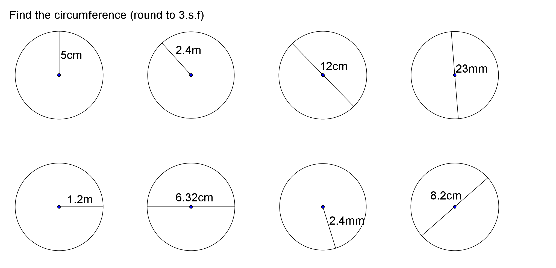

Slide 27
Notes Review
24, 7 ,30
Date
Title
Essential question
Notes complete
Notes complete with colour and diagrams
Questions completed
Contents page filed in
Formula page filled in

Slide 28
Homework
Review your notes and write a summary answering the essential question.

